Slide 1
Atomic Multicast (Group Communication)
Nasrin seifi
Computer science department
University of northern british columbia
Winter 2020

Slide 2
outline
Definition
Problem
Assumptions
Solution
Implementation
Demo

Slide 3
definition
Atomic Multicast
send a message to a specific set of processes
Properties: Validity: if a correct participant multicasts a message, then all correct participants will eventually receive it. Uniform Agreement: if one correct participant receives a message, then all correct participants will eventually receive that message. Uniform Integrity: a message is received by each participant at most once, and only if it was previously multicast. Uniform Total Order: the messages are totally ordered in the mathematical sense; that is, if any correct participant receives message 1 first and message 2 second, then every other correct participant must receive message 1 before message 2.

Slide 4
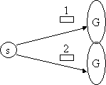
Problem
All the messages multicast should deliver in the same order in every process.
If a message is sent to a group and one member receives it, that member can be sure that all members will get the message.
No two correct processes deliver any two messages in a different order.

Slide 5
Assumption
Disjoint Group
Correct Processes
Reliable Channel
Failure because of Concurrency
Fully Connected Network
Asynchronous Message-passing
Global clock

Slide 6
Solution
The protocol we are considering to implement the AMCAST is based on a two-phase protocol by D. Skeen
This algorithm uses Lamport’s clocks to determine the logical time of the occurrence of an event
Halting Failures, whereby a process stops executing without performing any incorrect actions.
The protocol maintains a set of priority queues for each process:
One for each AMCAST label (buffers messages before placing them on the delivery queue)
Delivery Queue
AMCAST
Process P
AMCAST
Delivery Queue
AMCAST

Slide 7
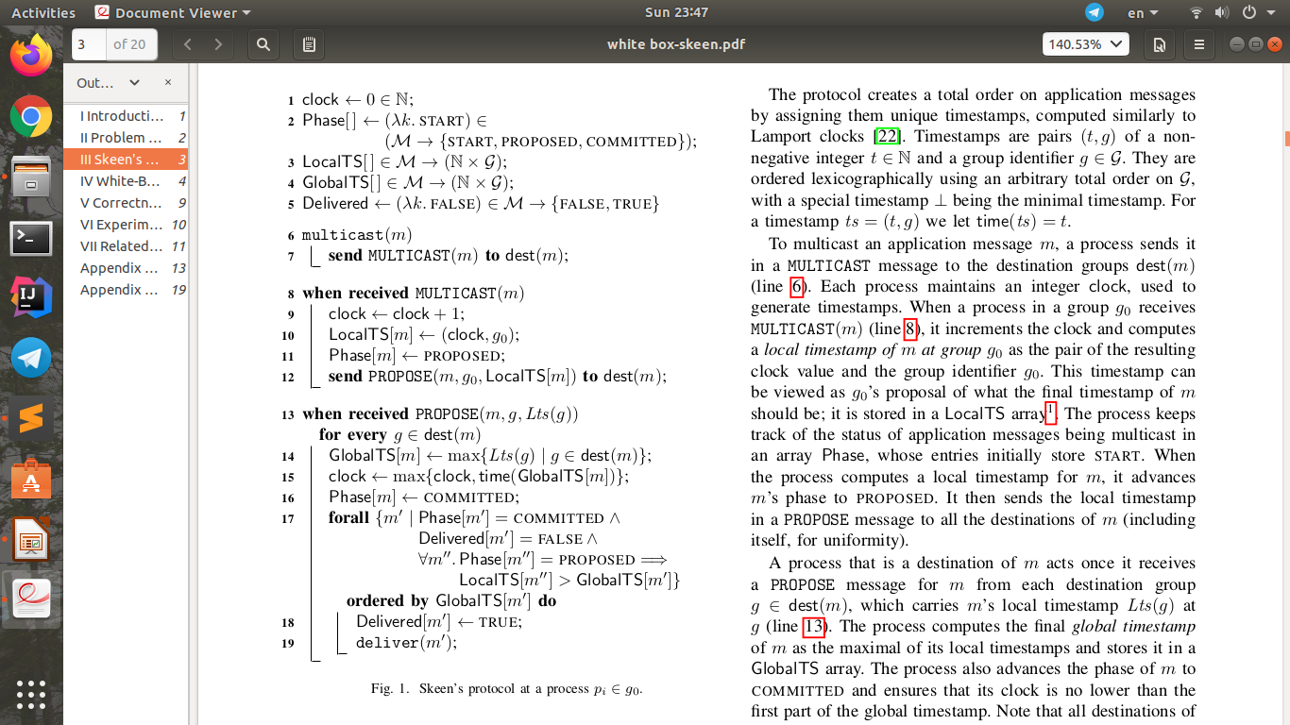
solution

Slide 8
implementation
After defining the problem, for solution part I surveyed many papers to find the Skeen Algorithm.
Based on the Algorithm, first the algorithm implemented without any GUI.
Then GUI added to the code, this step led to a big modification.

Slide 9
implementation
In the project, we used the Socket.
Socket connection needs a server for handling the Processes and Packets.
First, a server runs then it provides the connection port (1500)
Second, the Processes join the port to connect to network to communicate with each other

Slide 10
implementation
The server class only provides the connection and send the packets that the processes sent
The ProcessGUI class provides the connection to server and manage the Skeen Algorithm
The first message always send by the “send” button in the panel
Skeen Algorithm mostly implemented in the “ListenfromServer” class

Slide 11
Project
Server
Message
ProcessGUI
ClientThread
Logical Clock
ListenFromServer

Slide 12
demo

